Slide 1

Software complexity estimation
by Adam Bondarowicz

Slide 2
cocomo
"COnstructive COst MOdel"
COCOMO is a model designed by Barry Boehm to give an estimate of the number of man-months it will take to develop a software product.

Slide 3
cocomo
COCOMO consists of a hierarchy of three increasingly detailed and accurate forms.
Basic COCOMO - is a static, single-valued model that computes software development effort (and cost) as a function of program size expressed in estimated lines of code.
Intermediate COCOMO - computes software development effort as function of program size and a set of "cost drivers" that include subjective assessment of product, hardware, personnel and project attributes.
Detailed COCOMO - incorporates all characteristics of the intermediate version with an assessment of the cost driver's impact on each step (analysis, design, etc.) of the software engineering process.

Slide 4
basic cocomo
Used for:
Organic projects - relatively small, simple software projects in which small teams with good application experience work to a set of less than rigid requirements.
Semi-detached projects - intermediate (in size and complexity) software projects in which teams with mixed experience levels must meet a mix of rigid and less than rigid requirements.
Embedded projects - software projects that must be developed within a set of tight hardware, software, and operational constraints.

Slide 5
basic COCOMO equations
E=a_{b}(KLOC)^{b}_{b}
D=c_{b}(E)^{d}_{b}
P=E/D
E is the effort applied in person-months
D is the development time in chronological months
KLOC is the estimated number of delivered lines of code for the project (expressed in thousands)

Slide 6
cocomo coefficients
a_{b}, b_{b}, c_{b} and d_{b}
Software project ab bb cb db
Organic 2.4 1.05 2.5 0.38
Semi-detached 3.0 1.12 2.5 0.35
Embedded 3.6 1.20 2.5 0.32

Slide 7
Basic cocomo summary
Basic COCOMO is good for quick, early, rough order of magnitude estimates of software costs, but its accuracy is limited because of its lack of factors to account for differences in hardware constraints, personnel quality and experience, use of modern tools and techniques, and other project attributes known to have a significant influence on software costs.

Slide 8
Extended cocomo
The basic model is extended to consider a set of "cost driver attributes" that can be grouped into four major categories:

Slide 9
1. Product attributes
a. required software reliability
b. size of application data base
c. complexity of the product

Slide 10
2. Hardware attributes
a. run-time performance constraints
b. memory constraints
c. volatility of the virtual machine environment
d. required turnaround time

Slide 11
3. Personnel attributes
a. analyst capability
b. software engineer capability
c.applications experience
d. virtual machine experience
e. programming language experience

Slide 12
4. Project attributes
a. use of software tools
b. application of software engineering methods
c. required development schedule

Slide 13
Each of the 15 attributes is rated on a 6 point scale that ranges from "very low" to "extra high" (in importance or value)
Based on the rating, an effort multiplier is determined from tables published by Boehm [BOE81], and the product of all effort multipliers results is an effort adjustment factor (EAF). Typical values for EAF range from 0.9 to 1.4.

Slide 14
intermediate COCOMO equation
E = a_{i} KLOC ^{b}_{i} x EAF
E is the effort applied in person-months
KLOC is the estimated number of delivered lines of code for the project

Slide 15
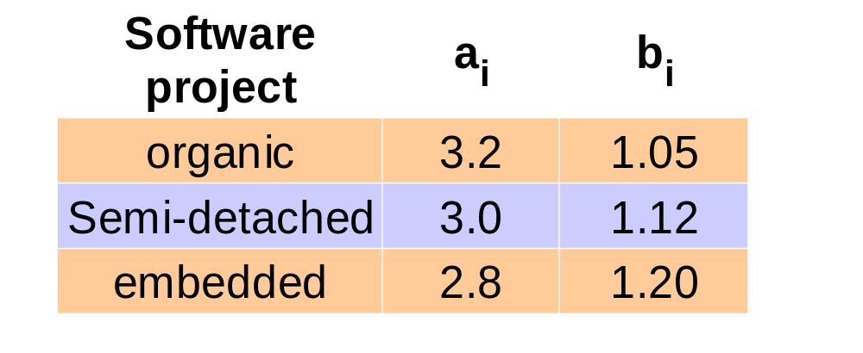
Intermediate cocomo coefficients

Slide 16
Example
Using the LOC estimate and the coefficients noted in table, we use the basic model to get:
E = 2.4 (KLOC) ^{1.05}
= 2.4 (33.2) ^{1.05}
= 95 person-months

Slide 17
Cocomo II
COCOMO II is a model that allows one to estimate the cost, effort, and schedule when planning a new software development activity. It consists of three submodels, each one offering increased fidelity the further along one is in the project planning and design process.

Slide 18
Compared to COCOMO I
COCOMO II is tuned to modern
software life cycles.
The original COCOMO model has been very successful, but it doesn't apply to newer software development practices as well as it does to traditional practices. COCOMO II targets the software projects of the 1990s and 2000s, and will continue to evolve over the next few years.

Slide 19
COCOMO II is really three different models:
The Application Composition Model
Suitable for projects built with modern GUI-builder tools. Based on new Object Points.
The Early Design Model
You can use this model to get rough estimates of a project's cost and duration before you've determined it's entire architecture. It uses a small set of new Cost Drivers, and new estimating equations. Based on Unadjusted Function Points or KSLOC.
The Post-Architecture Model
This is the most detailed COCOMO II model. You'll use it after you've developed your project's overall architecture. It has new cost drivers, new line counting rules, and new equations.

Slide 20
PM = A*(KSLOC)^B * Π(i=1..17)EMi
B = 1.01 + Σ(j=1..5)SF j
– A is a constant
– KSLOC is thousands of source lines of code
– EM are effort multipliers, parameters that effect effort
the same amount regardless of project size
– SF are scale factors, parameters that have large
influence on big projects and small influence on small
projects

Slide 21


Slide 22
8 cocomo II uses
- software development approach
- budget decisions
- production trade-offs
- IT capital planning
- investment options
- management decisions
- prioritizing projects
- SPI strategy

Slide 23
6 cocomo II Model Objectives
- accuracy
- customization
- model ease of use
- usefulness
- resource manager
- modifiability

Slide 24
Use Case Points Method

Slide 25
Use Case Points Method
The Use Case Points Method (UCPM) is an effort estimation algorithm proposed by Gustav Karner that employs Use Cases as a representation of system complexity based on system functionality.

Slide 26
Method summary
• Identify, classify and weight actors
• Identify, classify and weight use cases
• Identify and weight Technical Factors
• Identify and weight Environmental Factors
• Converting Points into Time
• Calculate Adjusted Use Case Points

Slide 27
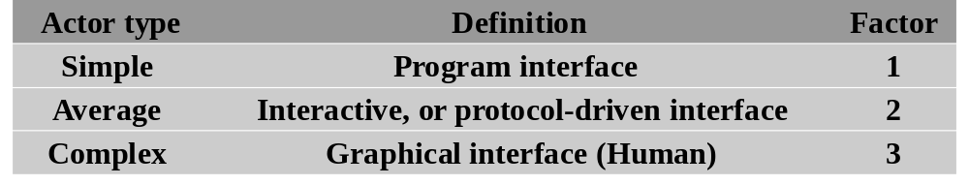
Identify, classify and weight actors
Actors are classified as either people or other systems. Each identified actor is given a weighting from 1-3 that corresponds to simple, average, and complex. Human actors are always classified as complex and receive a weighting of 3. Systems to which the new system will interface (legacy systems) are either simple or average depending on the mechanism by which they are addressed.
E.g.:
2 simple * 1 = 2
2 average * 2 = 4
3 complex * 3 = 9
Total actor weight = 2 + 4 + 9 = 15

Slide 28
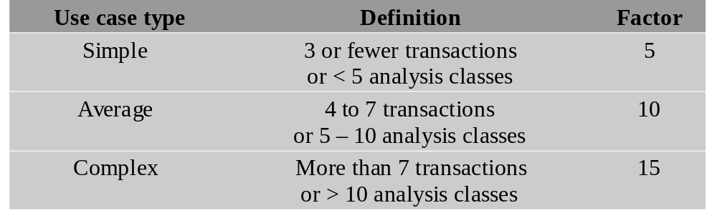
Identify, classify and weight use cases
E.g.:
5 simple * 5 = 25
4 average * 10 = 40
0 complex * 3 = 0
Total use case weight = 25 + 40 + 0 = 65
The Total actor weight and the Total use case weight are then summed to produce the Unadjusted Use Case Points (UUCP) score.
15 + 65 = 85
UUCP = 85

Slide 29
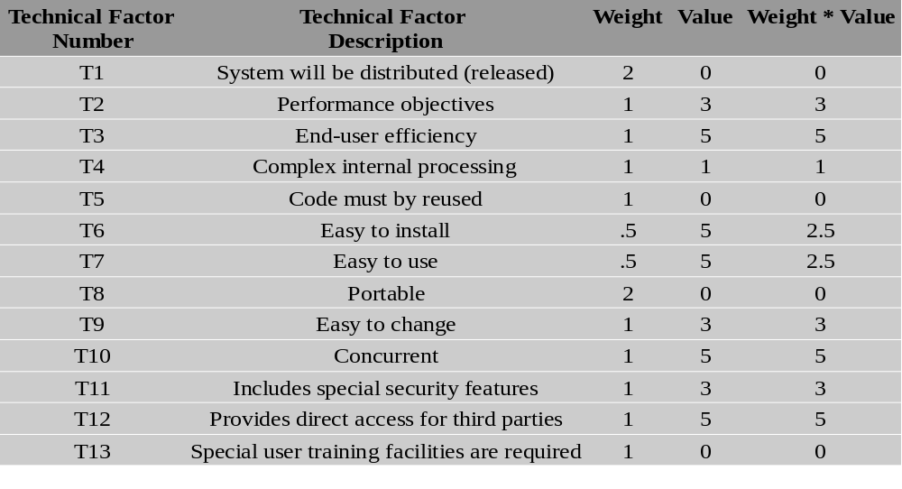
Identify and Weight Technical Factors
E.g.:
TFactor = Sum of Weight * Value column
TFactor = 30
Technical Complexity Factor (TCF) = 0.6 + (0.01 * TFactor)
TCF = 0.9

Slide 30
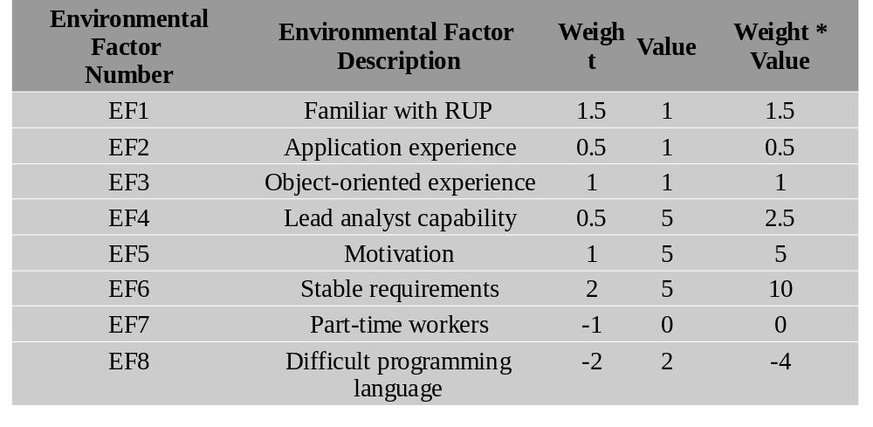
Identify and Weight Environmental Factors
E.g.:
EF-Factor = Sum of (Weight * Value) column
EF-Factor = 16.5
Environmental Complexity Factor (ECF) = 1.4 + (-0.03 * EF-Factor)
ECF = 0.905

Slide 31
Calculate Adjusted Use Case Points
Finally Use Case Points are calculated using this formula:
UCP = UUCP * TCF * ECF
E.g.:
UCP = UUCP * TCF * ECF
UCP = 80 * 0.9 * 0.905
UCP = 65.16 (65)

Slide 32
Converting Points into Time
It is recommended to convert each UCP to 20-28 hours

Slide 33
DELPHI
The Delphi technique is a method for obtaining forecasts from a panel of independent experts over two or more rounds. Experts are asked to predict quantities. After each round, an administrator provides an anonymous summary of the experts’ forecasts and their reasons for them. When experts’ forecasts have changed little between rounds, the process is stopped and the final round forecasts are combined by averaging.

Slide 34
Role of the facilitator
The person co-ordinating the Delphi method can be known as a facilitator, and facilitates the responses of their panel of experts, who are selected for a reason, usually that they hold knowledge on an opinion or view. The facilitator sends out questionnaires, surveys etc. and if the panel of experts accept, they follow instructions and present their views.

Slide 35
The Delphi method and forecasting
The Delphi method is a systematic interactive forecasting method based on independent inputs of selected experts.
Delphi method uses a panel of carefully selected experts who answer a series of questionnaires. Questions are usually formulated as hypotheses, and experts state the time when they think these hypotheses will be fulfilled. Each round of questioning is followed with the feedback on the preceding round of replies, usually presented anonymously. Thus the experts are encouraged to revise their earlier answers in light of the replies of other members of the group.

Slide 36
key characteristics of the Delphi method
1. Structuring of information flow
2. Regular feedback
3. Anonymity of the participants

Slide 37
Structuring of information flow
The initial contributions from the experts are collected in the form of answers to questionnaires and their comments to these answers.
The panel director controls the interactions among the participants by processing the information and filtering out irrelevant content. This avoids the negative effects of face-to-face panel discussions and solves the usual problems of group dynamics.

Slide 38
Regular feedback
Participants comment on their own forecasts, the responses of others and on the progress of the panel as a whole.
At any moment they can revise their earlier statements.
While in regular group meetings participants tend to stick to previously stated opinions and often conform too much to group leader, the Delphi method prevents it.

Slide 39
Anonymity of the participants
Usually all participants maintain anonymity. Their identity is not revealed even after the completion of the final report.
This stops them from dominating others in the process using their authority or personality, frees them to some extent from their personal biases, allows them to freely express their opinions, encourages open critique and admitting errors by revising earlier judgments.

Slide 40
Applications
First applications of the Delphi method were in the field of science.
Later the Delphi method was applied in other areas, especially those related to public policy issues, such as economic trends, health and education. It was also applied successfully and with high accuracy in business forecasting. For example, in one case reported by Basu and Schroeder (1977), the Delphi method predicted the sales of a new product during the first two years with inaccuracy of 3–4% compared with actual sales. Quantitative methods produced errors of 10–15%, and traditional unstructured forecast methods had errors of about 20%.

Slide 41
Function Point Analisys
Function points are a unit measure for software much like an hour is to measuring time, miles are to measuring distance or Celsius is to measuring temperature. Function Points are an ordinal measure much like other measures such as kilometers, Fahrenheit, hours, so on and so forth.

Slide 42
Objectives of Function Point Analysis
Since Function Points measures systems from a functional perspective - they are independent of technology. Regardless of language, development method, or hardware platform used, the number of function points for a system will remain constant. The only variable is the amount of effort needed to deliver a given set of function points; therefore, Function Point Analysis can be used to determine whether a tool, an environment, a language is more productive compared with others within an organization or among organizations. This is a critical point and one of the greatest values of Function Point Analysis.

Slide 43
The Five Major Components
External Inputs (EI)
External Outputs (EO)
External Inquiry (EQ)
Internal Logical Files (ILF’s)
External Interface Files (EIF’s)

Slide 44
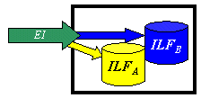
External Inputs (EI)
an elementary process in which data crosses the boundary from outside to inside. This data may come from a data input screen or another application. The data may be used to maintain one or more internal logical files. The data can be either control information or business information. If the data is control information it does not have to update an internal logical file.

Slide 45
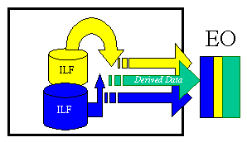
External Outputs (EO)
elementary process in which derived data passes across the boundary from inside to outside. Additionally, an EO may update an ILF. The data creates reports or output files sent to other applications. These reports and files are created from one or more internal logical files and external interface file.

Slide 46
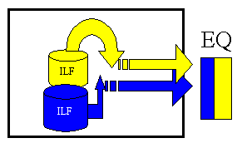
External Inquiry (EQ)
elementary process with both input and output components that result in data retrieval from one or more internal logical files and external interface files. The input process does not update any Internal Logical Files, and the output side does not contain derived data. The graphic below represents an EQ with two ILF's and no derived data.

Slide 47
Internal Logical Files (ILF’s):
a user identifiable group of logically related data that resides entirely within the applications boundary and is maintained through external inputs.
External Interface Files (EIF’s):
a user identifiable group of logically related data that is used for reference purposes only. The data resides entirely outside the application and is maintained by another application. The external interface file is an internal logical file for another application.

Slide 48
Functional Complexity
The first adjustment factor considers the Functional Complexity for each unique function.
Functional Complexity is determined based on the combination of data groupings and data elements of a particular function. The number of data elements and unique groupings are counted and compared to a complexity matrix that will rate the function as low, average or high complexity. Each of the five functional components (ILF, EIF, EI, EO and EQ) has its own unique complexity matrix. The following is the complexity matrix for External Outputs.
1-5 DETs 6 - 19 DETs 20+ DETs
0 or 1 FTRs L L A
2 or 3 FTRs L A H
4+ FTRs A H H
Complexity UFP
L (Low) 4
A (Average) 5
H (High) 7

Slide 49
Value Adjustment Factor - The Unadjusted Function Point count is multiplied by the second adjustment factor called the Value Adjustment Factor. This factor considers the system's technical and operational characteristics and is calculated by answering 14 questions. The factors are:
1. Data Communications
The data and control information used in the application are sent or received over communication facilities.
2. Distributed Data Processing
Distributed data or processing functions are a characteristic of the application within the application boundary.
3. Performance
Application performance objectives, stated or approved by the user, in either response or throughput, influence (or will influence) the design, development, installation and support of the application.
4. Heavily Used Configuration
A heavily used operational configuration, requiring special design considerations, is a characteristic of the application.
5. Transaction Rate
The transaction rate is high and influences the design, development, installation and support.

Slide 50
6. On-line Data Entry
On-line data entry and control information functions are provided in the application.
7. End -User Efficiency
The on-line functions provided emphasize a design for end-user efficiency.
8. On-line Update
The application provides on-line update for the internal logical files.
9. Complex Processing
Complex processing is a characteristic of the application.
10. Reusability
The application and the code in the application have been specifically designed, developed and supported to be usable in other applications.
11. Installation Ease
Conversion and installation ease are characteristics of the application. A conversion and installation plan and/or conversion tools were provided and tested during the system test phase.
12. Operational Ease
Operational ease is a characteristic of the application. Effective start-up, backup and recovery procedures were provided and tested during the system test phase.
13. Multiple Sites
The application has been specifically designed, developed and supported to be installed at multiple sites for multiple organizations.
14. Facilitate Change
The application has been specifically designed, developed and supported to facilitate change.

